Slide 1
DIVYA DHARSHINI K
PERSONALIZED VOICE ASSISTANT
3/21/2024 Annual Review

Slide 2

PERSONALIZED VOICE ASSISTANT
3/21/2024 Annual Review

Slide 3


AGENDA 1. Understanding User Preferences: Analyze user interactions to comprehend preferences in music, news, and other content. 2. Tailored Recommendations: Provide personalized recommendations based on past interactions and user preferences. 3. Adaptive Learning: Continuously learn from user feedback and adapt responses to better suit individual needs. 4. Contextual Understanding: Utilize contextual cues to anticipate user needs and deliver more relevant responses. 5. Privacy Protection: Ensure strict privacy measures are in place to safeguard user data while offering personalized experiences.
3/21/2024 Annual Review

Slide 4


PROBLEM STATEMENT The challenge of personalized voice assistants lies in effectively interpreting user preferences, habits, and context in real-time interactions while maintaining privacy. Ensuring seamless integration across devices and platforms further complicates the development process. Additionally, optimizing user engagement and satisfaction while managing ethical considerations poses another significant challenge.
3/21/2024 Annual Review

Slide 5

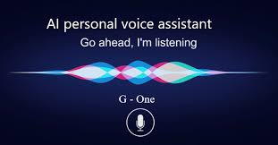
PROJECT OVERVIEW The project aims to develop a personalized voice assistant leveraging natural language processing and machine learning techniques. Key objectives include accurately understanding user preferences, adapting responses dynamically, and ensuring data privacy. The project will integrate across various platforms and devices, focusing on optimizing user engagement while addressing ethical considerations.
3/21/2024 Annual Review

Slide 6


WHO ARE THE END USERS? The end users of the personalized voice assistant could encompass a broad spectrum of individuals, including consumers, professionals, and organizations across various industries. Consumers may use it for daily tasks, such as managing schedules, accessing entertainment, and controlling smart home devices. Professionals could leverage it for productivity-enhancing activities like scheduling meetings, conducting research, and accessing relevant information hands-free. Organizations might integrate it into customer service operations, improving responsiveness and enhancing user experiences. Overall, the end users range from individual consumers to business entities seeking efficient and personalized voice-enabled solutions.
3/21/2024 Annual Review

Slide 7
YOUR SOLUTION AND ITS VALUE PROPOSITION
Our solution is a highly customizable and intelligent voice assistant that understands user preferences, adapts responses accordingly, and prioritizes data privacy. By employing cutting-edge natural language processing and machine learning techniques, our voice assistant offers a seamless and personalized experience across various platforms and devices. Its value proposition lies in its ability to streamline tasks, enhance productivity, and provide tailored recommendations while prioritizing user privacy and security. Whether for individual users seeking convenience in daily tasks or organizations aiming to optimize efficiency and customer interactions, our personalized voice assistant offers unmatched value in today's digital landscape.
3/21/2024 Annual Review

Slide 8

THE WOW IN YOUR SOLUTION The "wow" factor in our solution lies in its ability to intuitively anticipate user needs and preferences, providing a truly personalized experience that feels almost human-like in its understanding and responsiveness. By continuously learning and adapting to user interactions, our voice assistant becomes a trusted companion, effortlessly simplifying tasks and enhancing productivity. Its seamless integration across platforms and devices ensures accessibility wherever and whenever users need assistance. Moreover, our unwavering commitment to privacy and security sets us apart, offering users peace of mind while enjoying the convenience and efficiency of our innovative voice assistant solution.
3/21/2024 Annual Review
8

Slide 9
MODELLING
In the modeling phase of developing a personalized voice assistant, we employ various techniques and approaches to create a robust system that accurately understands user inputs and provides relevant responses. This involves:
Data Collection and Preprocessing
Feature Engineering
Model Selection
Training and Evaluation
Deployment and Integration
Monitoring and Maintenance
3/21/2024 Annual Review
9

Slide 10
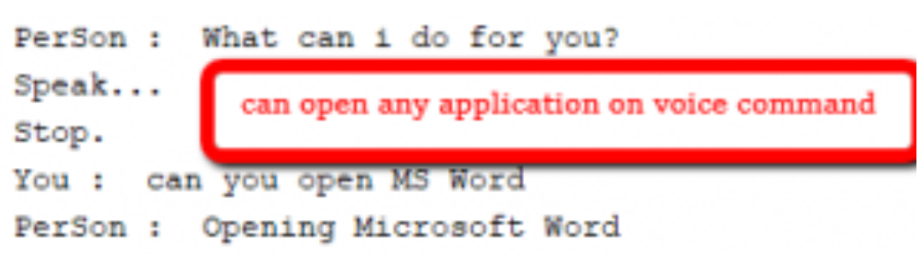
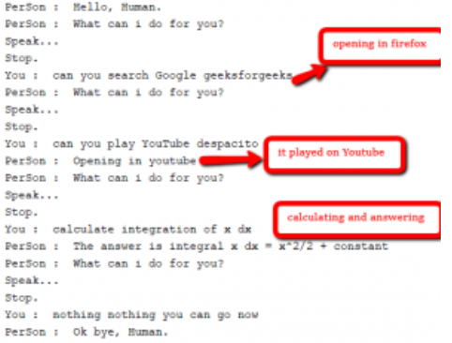
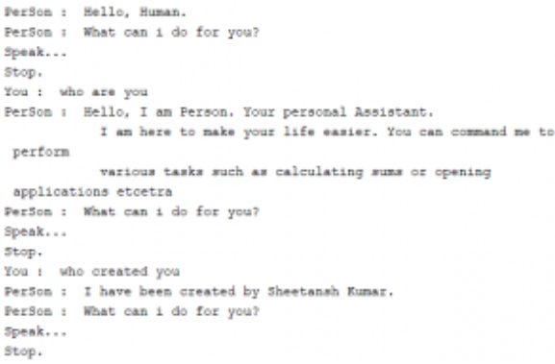
RESULTS
Demo Link
3/21/2024 Annual Review
10

